Slide 1

Restaurant Location Recommender
IBM data science capstone

Slide 2
Objectives
Analyze the data .
Make a recommendation.
Summarize the results.

Slide 3
Business Problem
If someone is looking to open a restaurant, where would you recommend that they open it and what kind of restaurant would it be? Which Neighborhood and should it be a cafe or fast food restaurant or a bar? This would help aspiring restaurant/Cafe/Fast food joint owners decide in which neighborhood can they set up shop and would their business be unique enough to thrive in the locality. The recommendation would be made by analysis of the neighborhoods and allow the owners to make a well recommended and smart choice.

Slide 4
Data
I have used new York data made available in the course.
I have used Foursquare api to get additional information about the neighborhoods.

Slide 5
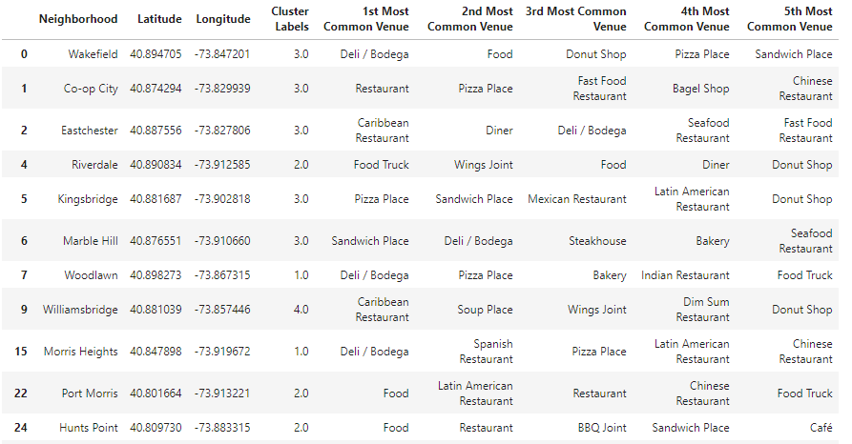
Analysis
The neighborhoods have been assigned different cluster label using k means clustering.
These labels help to identify neighbourhoods which have a high number of restaurant locations.

Slide 6
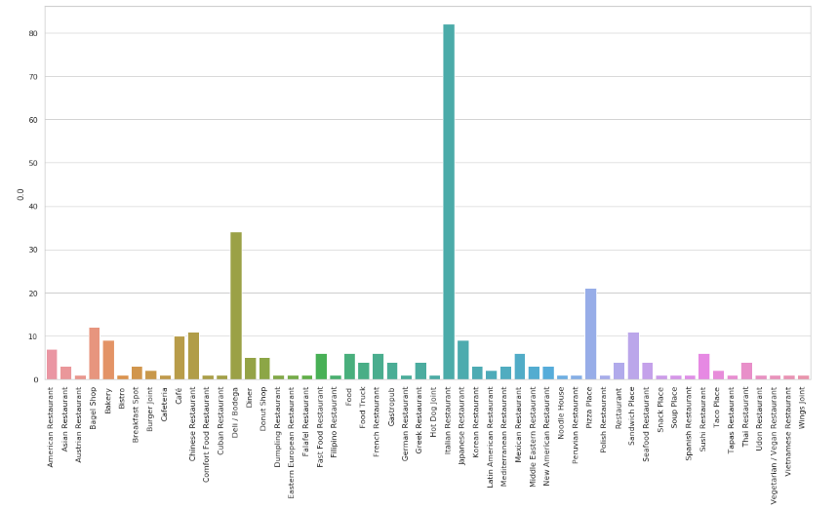
Results
For cluster 1 we can see high number and different types of restaurants.

Slide 7
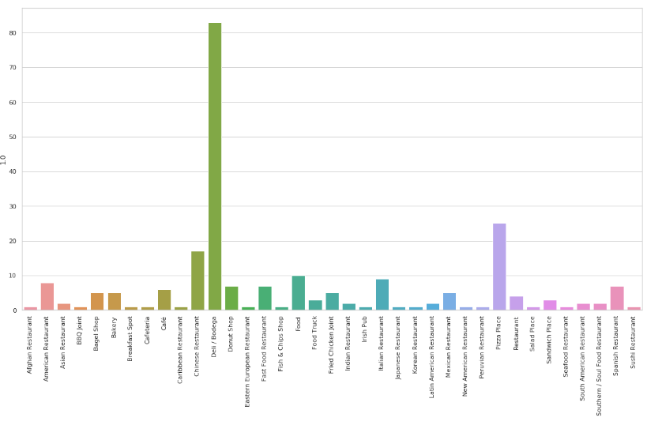
Results
Even For cluster 2 we can see high number and different types of restaurants but type of restaurant is lesser than cluster 1.

Slide 8
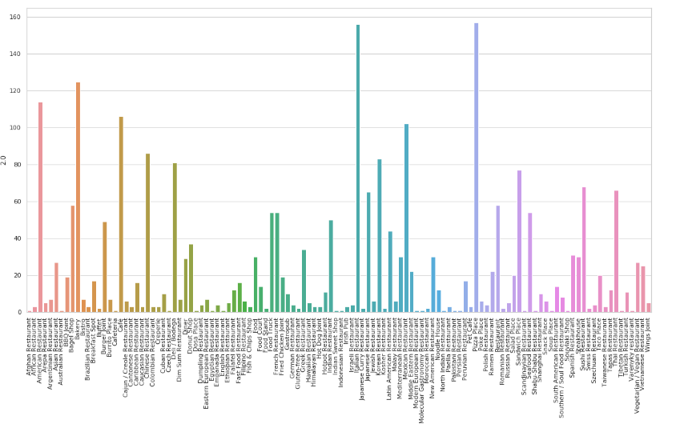
Results
That’s right
Cluster 3 is out of options for new location of restaurants, as you can see it has too many restaurants.

Slide 9
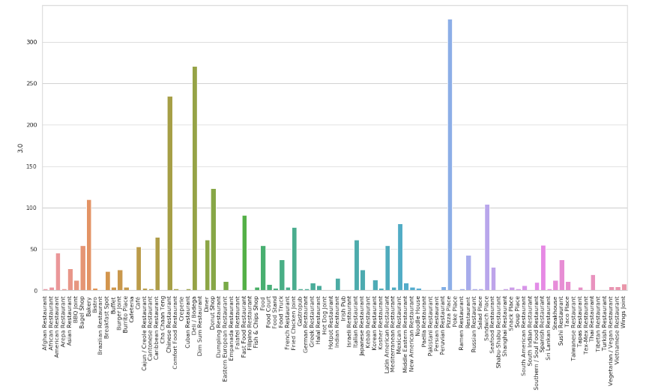
Results
Cluster number 4 has lower number of restaurants but similar number of types of restaurants compared to cluster 3

Slide 10
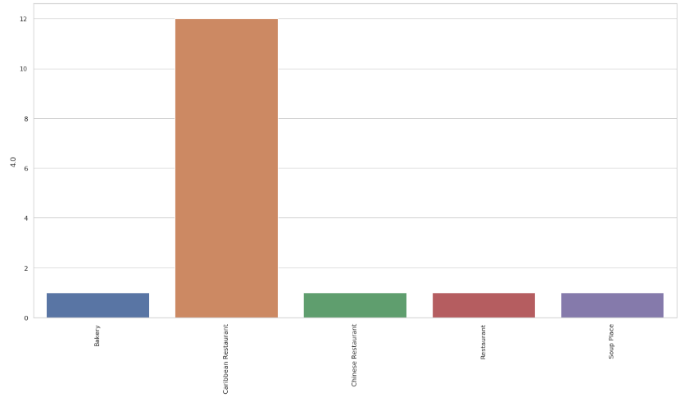
Results
Cluster 5 neighborhoods are much less competitive in terms of quantity and type of restaurants available making it our best choice for opening the restaurants

